Slide 1
专业外语
软件工程 物联网
2023-2-1

Slide 2
PART 1 COMPUTER ARCHITETURE AND COMPUTER NETWORK CHAPTER 2 System Software 2.1 WINDOWS 10

Slide 3
KEYWORDS
codename 代号
availability 可用性，有效性，利用率，利用度
upgrade 升级，提高
licensed 特许的，许可的
architecture 体系结构，结构，
层次结构，总体结构，结构格式
family 族，类，系列，种类
phased out 逐渐淘汰
console 控制台
embedded 嵌入式的
platform 平台
browser 浏览器

Slide 4
touch 触摸
button 按钮
taskbar 任务栏（条）
tile 平铺（并列）显示，铺切
resize 调整（重设）大小
framework 框架，构架，架构，体制组织
trackpad 跟踪垫（板），轨迹板
snap 抓取，快照，取图，快速移动
icon 图标，图符
default 默认，缺省
addressing 编址，寻址，定址
screenshot 屏幕快照
Snap Assist 抓取助手 window 视窗

Slide 5
2.1 Windows 10
Windows 10 is an upcoming operating system developed by Microsoft as part of the Windows NT family of operating systems.
First presented in April 2014 at the Build Conference, it is scheduled to be released in mid-2015, and is currently in public beta testing through the Windows Insider program.
During its first year of availability, upgrades to Windows 10 will legally be offered at no charge for licensed consumer users of Windows 7 and Windows 8.1.

Slide 6
The goal of Windows 10 is to unify the Windows PC, Windows Phone, Windows Embedded and Xbox One product families around a common internal core.
These products will share a common, “universal” application architecture and Windows Store ecosystem that expands upon the Windows Runtime platform introduced by Windows 8.
Windows 10 will also introduce a new bundled web browser, Microsoft Edge, to replace Internet Explorer.
Figure 2-1 shows a Screenshot of Windows 10.

Slide 7
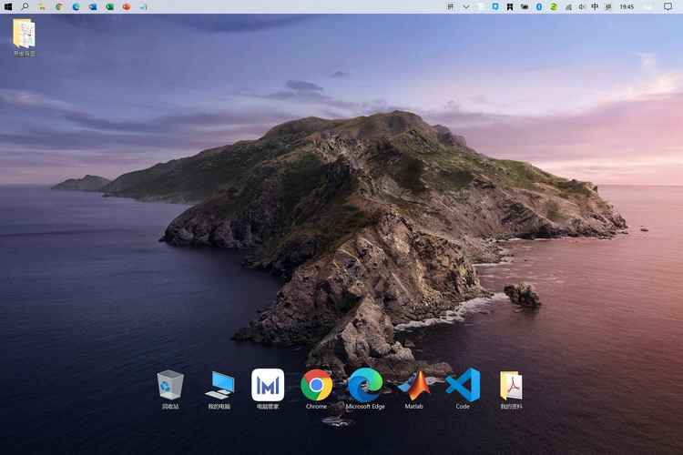
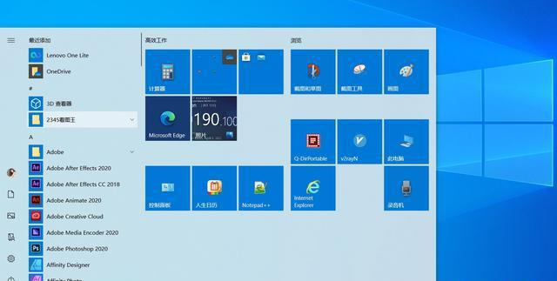

Slide 8
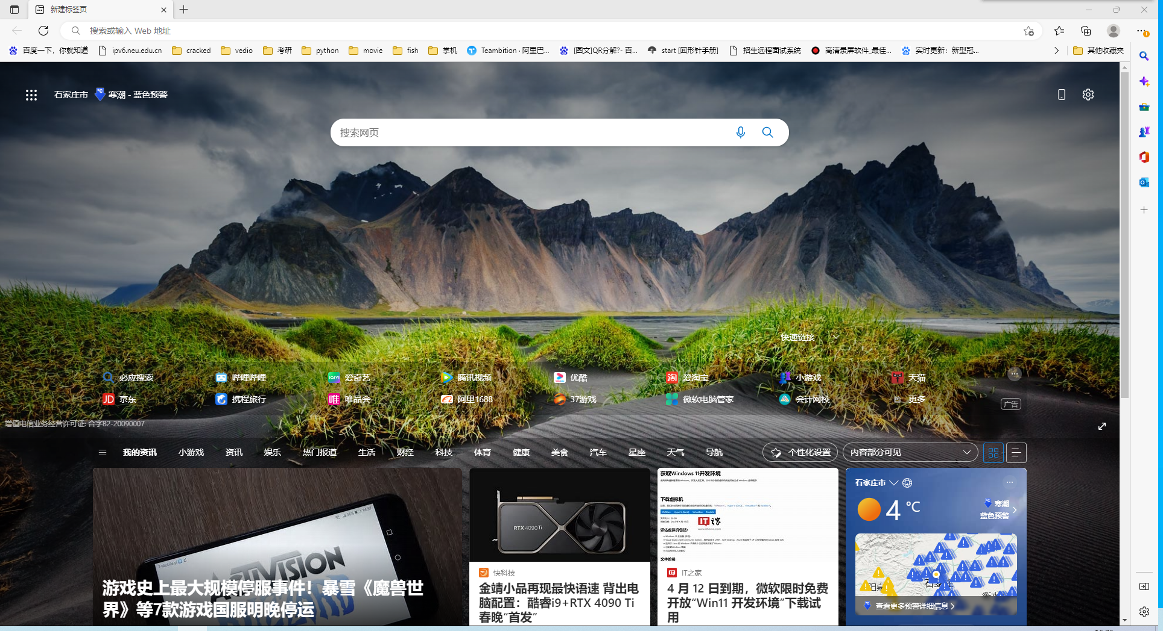
Microsoft Edge

Slide 9
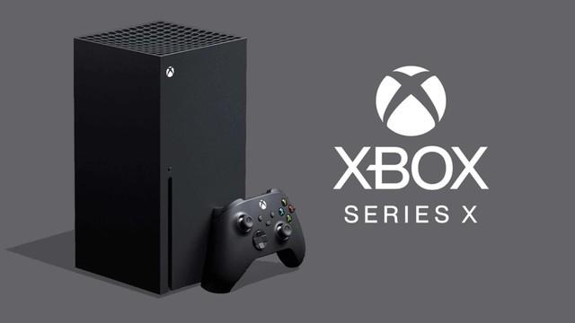
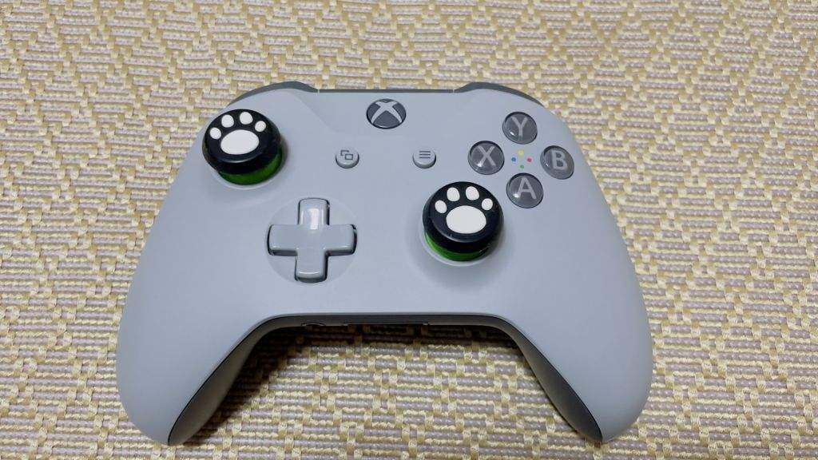
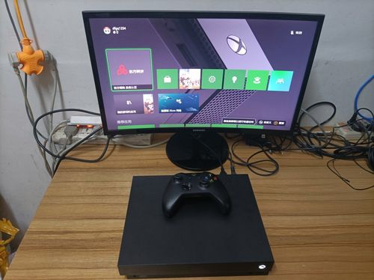
From the Internet

Slide 10
1. User interface and desktop
Windows 10’s user interface is an evolution of Windows 8’s, it changes its behavior depending on the type of device being used and available input methods.
When a keyboard is attached, users are asked if they want to switch to a user interface mode that is optimized for mouse and keyboard, or stay within the touch-optimized mode.

Slide 11
A new iteration of the Start menu is used, with an application list and the “All apps” button on the left side, and live tiles on the right.
The menu can be resized, and expanded into a full-screen display, which is the default option in touch environments.

Slide 12
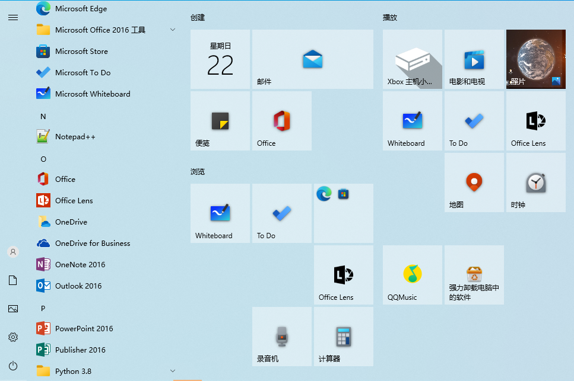

Slide 13
A new virtual desktop system known as Task View was added.
Clicking the Task View button on the taskbar or swiping from the left side of the screen displays all open windows and allows users to switch between them, or switch between multiple workspaces.

Slide 14
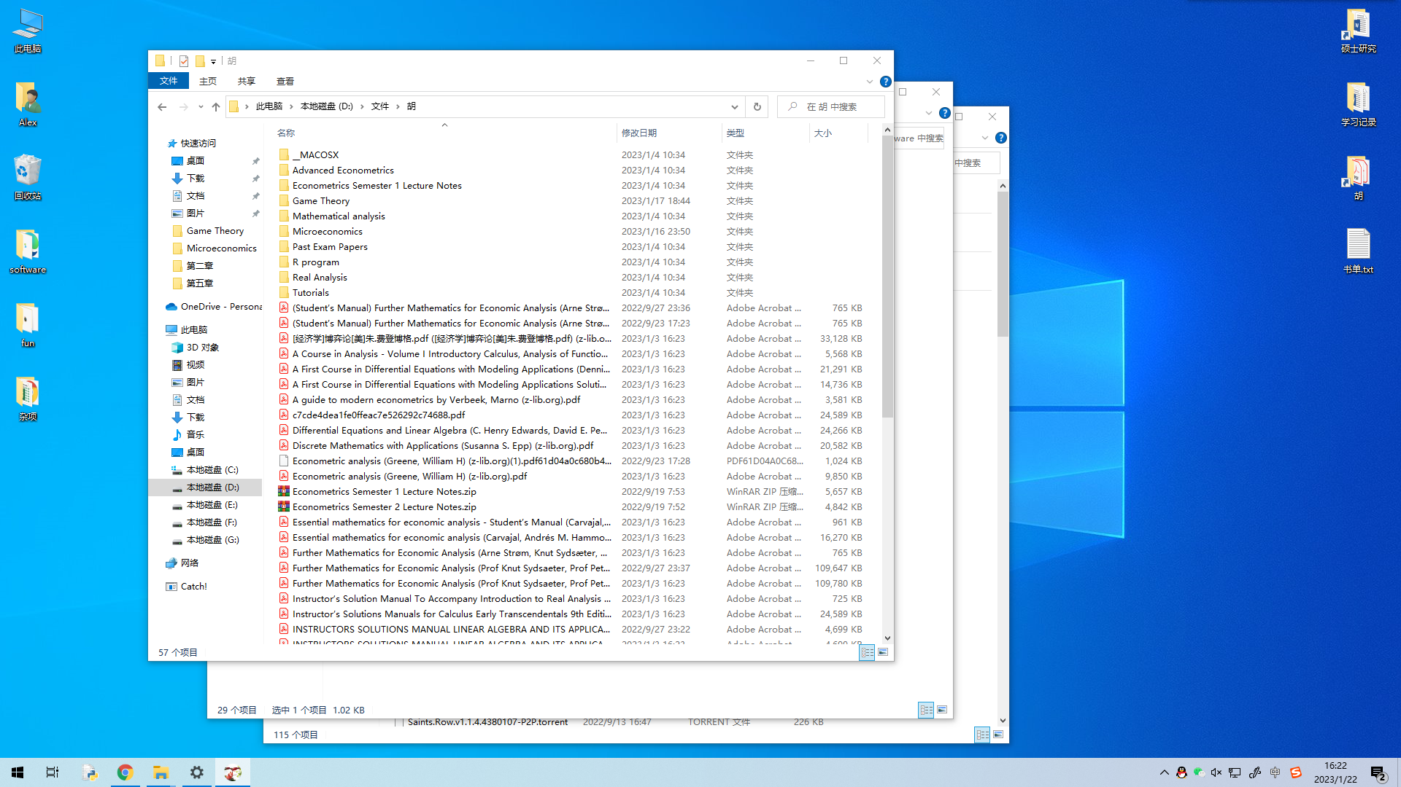

Slide 15
Windows Store apps, which previously could only be used full-screen, can now be used in desktop windows or full-screen mode.
Program windows can now be snapped to quadrants of the screen by dragging them to the corner.
When a window is snapped to one side of the screen, the user is prompted to choose a second window to fill the unused side of the screen (called “Snap Assist”).

Slide 16
2. Features
A major aspect of Windows 10 is a focus on harmonizing user experiences between different classes of devices, along with addressing shortcomings in the Windows user interface that was first introduced in Windows 8.

Slide 17
The Windows Store app ecosystem has been revised into “Windows apps”.
They are made to run across multiple platforms and device classes, including smartphone, tablet, Xbox One, and other compatible Windows 10 devices.
Windows apps share code across platforms, have responsive designs that adapt to the needs of the device and available inputs, can synchronize data between Windows 10 devices (including notifications, credentials, and allowing cross-platform multiplayer for games), and will be distributed through a unified Windows Store.

Slide 18
Developers can allow “cross-buys”, where purchased licenses for an app apply to all of the user’s compatible devices, rather than only the one they purchased on (i.e. a user purchasing an app on PC is also entitled to use the smartphone version at no extra cost).

Slide 19
Windows 10 will also allow web apps and desktop software (using either Win32 or .NET Framework) to be packaged for distribution on Windows Store.
Desktop software distributed through Windows Store will be packaged using the App-V system to allow sandboxing.

Slide 20
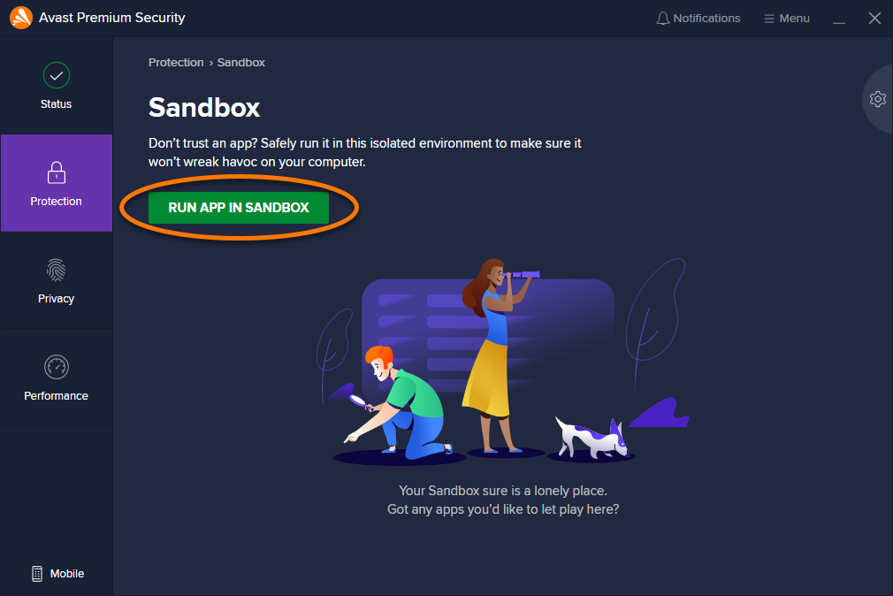
From the Internet

Slide 21
3. Windows 10 Editions
As in the past, we will offer different Windows editions that are tailored for various device families and uses.
These different editions address specific needs of our various customers, from consumers to small businesses to the largest enterprises.

Slide 22
Windows 10 Home is the consumer-focused desktop edition.
It offers a familiar and personal experience for PCs, tablets and 2-in-1s.
Windows 10 Mobile is designed to deliver the best user experience on smaller, mobile, touch-centric devices like smartphones and small tablets.
Windows 10 Pro is a desktop edition for PCs, tablets and 2-in-1s.
Building upon both the familiar and innovative features of Windows 10 Home, it has many extra features to meet the diverse needs of small businesses.

Slide 23
Windows 10 Enterprise builds on Windows 10 Pro, adding advanced features designed to meet the demands of medium and large sized organizations.
Windows 10 Education builds on Windows 10 Enterprise, and is designed to meet the needs of schools – staff, administrators, teachers and students.
Windows 10 Mobile Enterprise is designed to deliver the best customer experience to business customers on smartphones and small tablets.

Slide 24
2.2 UNIX and LINUX

Slide 25
KEYWORDS
UNIX 一种计算机操作系统
workstation 工作站
multi-user 多用户
multi-task 多任务
job 作业
kernel 内核
interface 接口，界面
system call 系统调用
interpreter 解释程序
disk file 磁盘文件
redirection 重定向

Slide 26
device-independent 设备无关的
shell 外壳（程序）、命令解释程序
Linux 以Linux命名的操作系统
Gnu’s Not UNIX (GNU) 一个自由软件组织
embedded system 嵌入式系统
firmware 固件
tailor 设计，裁剪，加工，处理，编（特）制
port 移植，端口
localization 局部化，地方化，本地化
security 安全，安心，防护，保障
widget 小装置（窗口），
窗口软件设计工具，界面构造（组件），
图形设备，数据类型
GUI (Graphic User Interface) 图形用户界面
human-machine interface 人机界面

Slide 27
1. UNIX
UNIX is an operating system originally developed by Dennis Ritchie and Ken Thompson at AT &T Bell Laboratories that allows a computer to handle multiple users and programs simultaneously.
Since its development in the early 1970s, UNIX has been enhanced by many individuals and particularly by computer scientists at the University of California, Berkeley (known as Berkeley Software Distribution UNIX, or BSD UNIX).

Slide 28
This operating system is available on a wide variety of computer systems, ranging from personal computers to mainframes, and is available in other related forms.
AIX is in implementation that runs on IBM workstations, A/UX is a graphical version that runs on Macintosh computers; Solaris runs on Intel microprocessors.

Slide 29
Features：
(1) The UNIX system can support multi-users and multi-tasks
(2) The UNIX System Kernel
The kernel is the heart of the UNIX operating system, responsible for controlling the computer’s resources and scheduling user jobs so that each one gets its fair share of the resources.
Programs interact with the kernel through special functions with well-known names, called system calls.

Slide 30
(3) The shell
The shell is a command interpreter that acts as an interface between users and the operating system.
When you enter a command at a terminal, the shell interprets the command and calls the program you want.

Slide 31
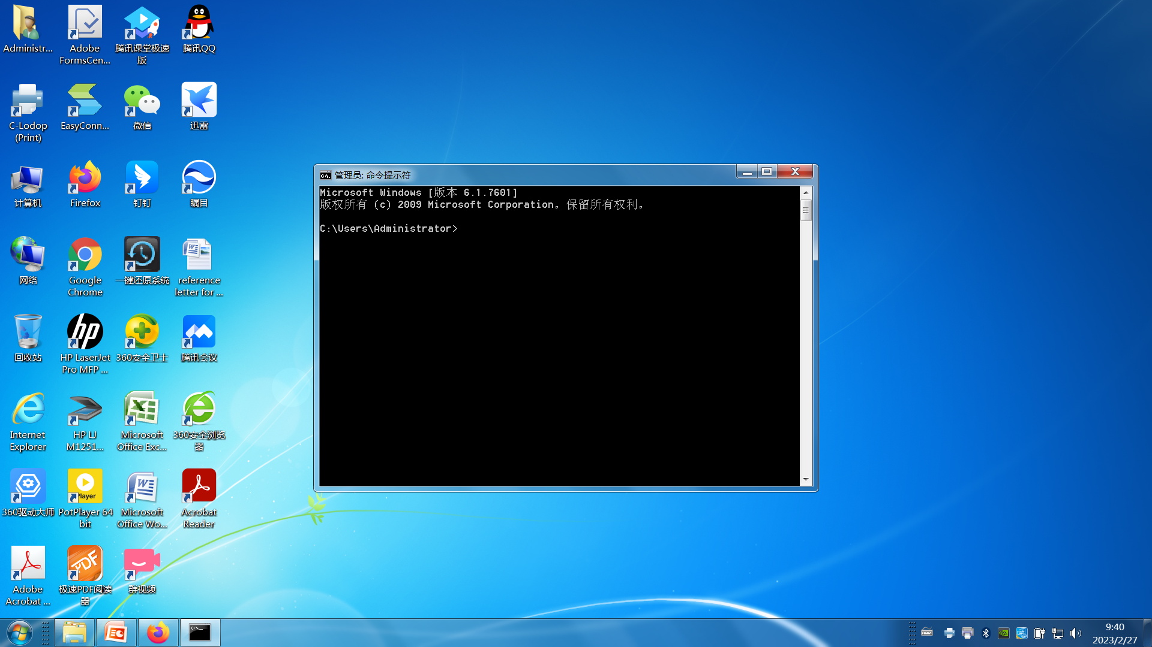

Slide 32
(4) Device-Independent Input and Output
Devices (such as a printer or terminal) and disk files all appear as files to UNIX programs.
When you give the UNIX operating system a command, you can instruct it to send the output to any one of several devices or files.
This diversion is called output redirection.

Slide 33
2. Linux
Linux is a UNIX-like and mostly POSIX-compliant computer operating system assembled under the model of free and open-source software development and distribution.
The defining component of Linux is the Linux kernel, an operating system kernel first released on 5 October 1991 by Linus Torvalds.
The Free Software Foundation uses the name GNU/Linux to describe the operating system, which has led to some controversy.

Slide 34
Linux was originally developed as a free operating system for Intel x86–based personal computers, but has since been ported to more computer hardware platforms than any other operating system.
It is the leading operating system on servers and other big iron systems such as mainframe computers and supercomputers, but is used on only around 1.5% of desktop computers.
Linux also runs on embedded systems, which are devices whose operating system is typically built into the firmware and is highly tailored to the system.
Android, the most widely used operating system for tablets and smartphones, is built on top of the Linux kernel.

Slide 35
(1) Hardware support
Linux kernel is a widely ported operating system kernel; it runs on a highly diverse range of computer architectures, including the hand-held ARM-based iPAQ and the IBM mainframes System z9 or System z10—covering devices ranging from mobile phones to supercomputers, as showing as Figure 2-2.

Slide 36
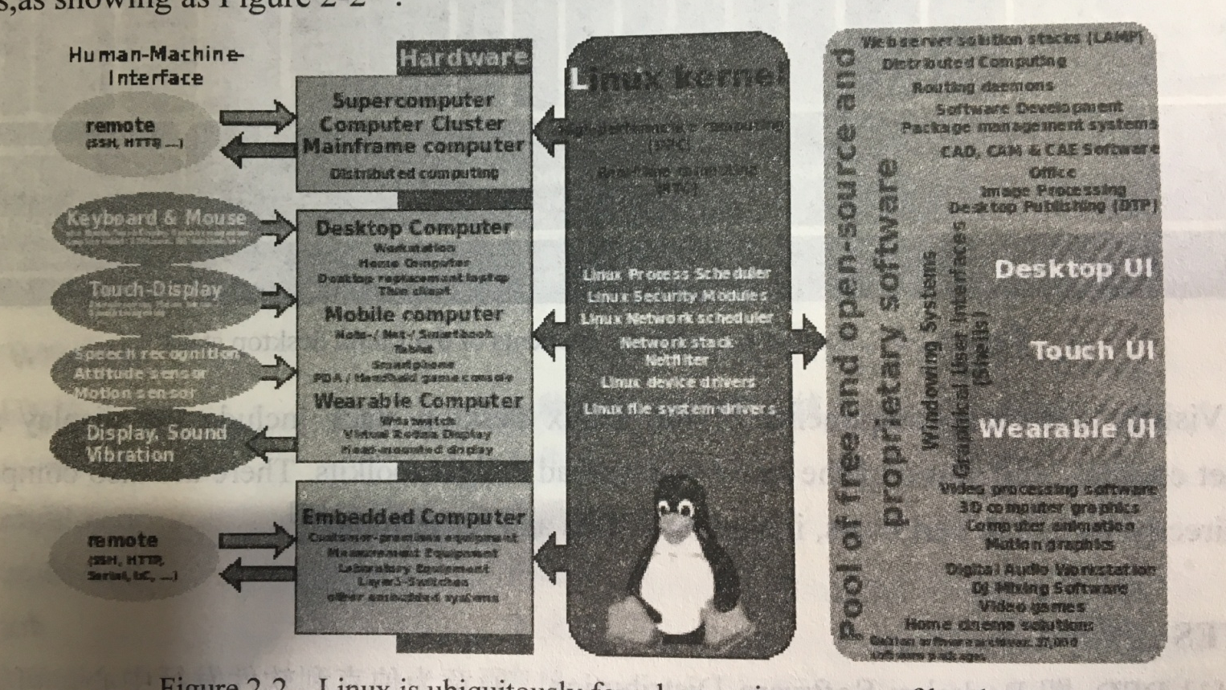
Figure 2-2 Linux is ubiquitously found on various types of hardware

Slide 37
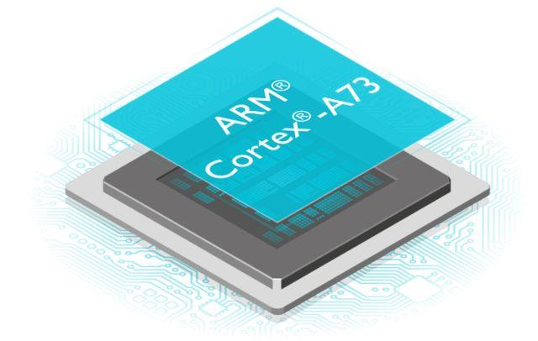

From the Internet

Slide 38
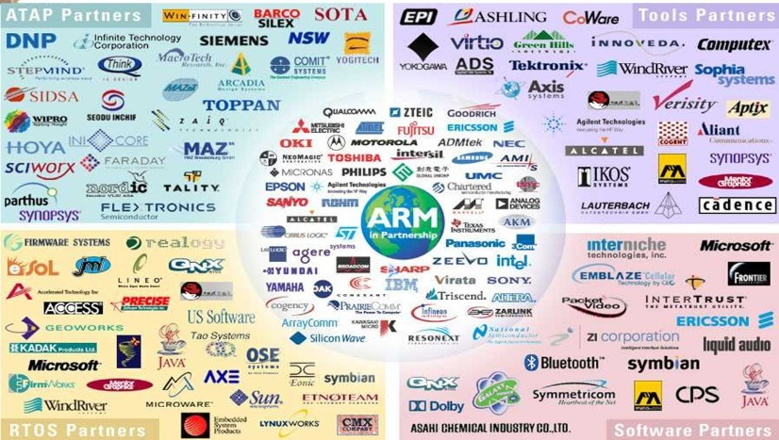
From the Internet

Slide 39
(2) Uses
Beside the Linux distributions designed for general-purpose use on desktops and servers, distributions may be specialized for different purposes including: computer architecture support, embedded systems, stability, security, localization to a specific region or language, targeting of specific user groups, support for real-time applications, or commitment to a given desktop environment.

Slide 40
As of 2015, over four hundred Linux distributions are actively developed, with about a dozen distributions being most popular for general-purpose use.

Slide 41
(3) Desktop
The popularity of Linux on standard desktop computers and laptops has been increasing over the years.
Currently most distributions include a graphical user environment, with the two most popular environments being GNOME (which can utilize additional shells such as the default GNOME Shell and Ubuntu Unity), and the KDE Plasma Desktop.

Slide 42
No single official Linux desktop exists: rather desktop environments and Linux distributions select components from a pool of free and open-source software with which they construct a GUI implementing some more or less strict design guide.

Slide 43
GNOME, for example, has its human interface guidelines as a design guide, which gives the human–machine interface an important role, not just when doing the graphical design, but also when considering pople with disabilities, and even when focusing on security.

Slide 44
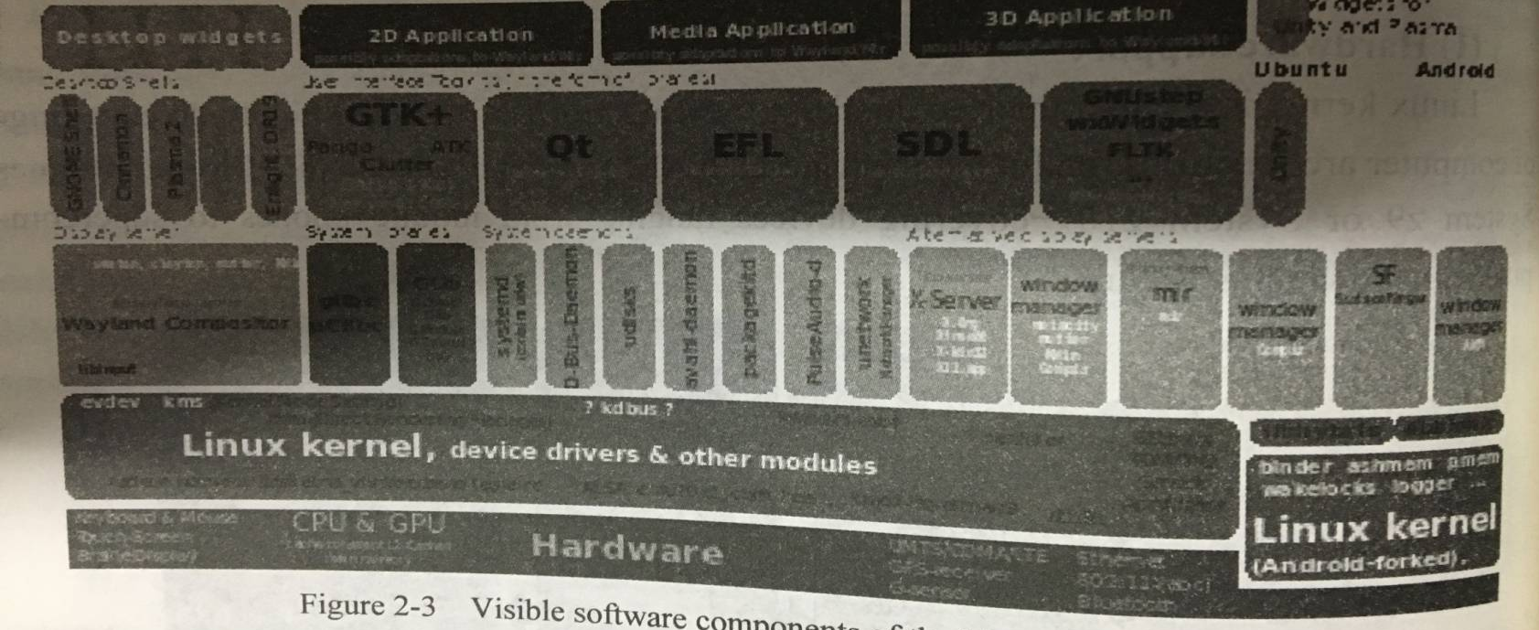
Figure 2-3 shows the Visible software components of the Linux desktop stack.
Figure 2-3 Visible software components of the Linux desktop stack Visible software components of the Linux desktop stack include the display server, idget engines, and some of the more widespread widget toolkits. There are also compwonents users, not directly visible to end including D-Bus and PulseAudio.

Slide 45
2.3 ANDROID

Slide 46
KEYWORDS
middleware 中间件
API (Application Program Interface) 应用程序接口
framework 框架，构架，架构，体制组织
smartphone 智能手机，智能电话
lightweight relational database 小型关系型数据库
streaming media 流媒体
threaded text messaging 线程文本消息
source code 源代码
proprietary software 专有软件，专利软件
alliance 联合，联盟

Slide 47
consortium 会，社，联盟，
合作，财团，联营企业，
国际性企业
telecommunication 电信，远程通信
layout 布局，布置，格式方案，
规划，设计，草图，轮廓

Slide 48
Android is an operating system for touchscreen mobile devices such as smartphones and tablet computers.
It is developed by the Open Handset Alliance—a consortium of hardware, software, and telecommunication companies led by Google.
Android consists of a kernel based on the Linux kernel, with middleware, libraries and APIs written in C and application software running on an application framework which includes Java-compatible libraries based on Apache Harmony.

Slide 49
As of July 2013 the Google Play store has had over one million Android applications (“apps”) published, and over 50 billion applications downloaded.
A developer survey conducted in April—May 2013 found that 71% of mobile developers develop for Android.
At Google I/O 2014, the company revealed that there were over one billion active monthly Android users, up from 538 million in June 2013.
As of 2015, Android has the largest installed base of all general-purpose operating systems.

Slide 50
Android’s source code is released by Google under open source licenses, although most Android devices ultimately ship with a combination of open source and proprietary software, including proprietary software developed and licensed by Google.

Slide 51
Android is popular with technology companies which require a ready-made, low-cost and customizable operating system for high-tech devices.
Android’s open nature has encouraged a large community of developers and enthusiasts to use the open-source code as a foundation for community-driven projects, which add new features for advanced users or bring Android to devices which were officially released running other operating systems.
The operating system’s success has made it a target for patent litigation as part of the so-called “smartphone wars” between technology companies.

Slide 52
Current features and specifications in handset layouts include
(1) Platform
The platform is adaptable to larger, VGA, 2D graphics library, 3D graphics library based on OpenGL ES 2.0 specifications, and traditional smartphone layouts.
(2) Storage
SQLite, a lightweight relational database, is used for data storage purposes.

Slide 53
(3) Connectivity
Android supports connectivity technologies including GSM/EDGE, IDEN, CDMA, EV-DO, UMTS, Bluetooth, Wi-Fi, and etc.
(4) Messaging
SMS and MMS are available forms of messaging, including threaded text messaging and now Android Cloud To Device Messaging( C2DM is also a part of Android Push Messaging service.

Slide 54
(5) Web browser
The web browser available in Android is based on the open-source WebKit layout engine, coupled with Chrome’s V8 JavaScript engine.
(6) Java support
While most Android applications are written in Java, there is no Java Virtual Machine in the platform and Java byte code is not executed.

Slide 55
(7) Media support
Android supports the following audio/video/still media formats: MP3, MIDI, WAV, JPEG, PNG, GIF, BMP and so forth.
(8) Streaming media support
RTP/RTSP streaming, HTML progressive download, Adobe Flash Streaming (RTMP) and HTTP Dynamic Streaming are supported.

Slide 56
(9) Additional hardware support
Android can use televisions (Android TV), car (Android Auto), wrist watches (Android Wear), still/digital cameras, game consoles, touchscreens, GPS, etc.
(10) Video calling
Android does not support native video calling, but some handsets have a customized version of the operating system that supports it.
There are another supports in handset layouts, they are multiple language, multitasking, multi-touch, bluetooth, voice based features, and screen capture.

Slide 57
The End of this Section

